Slide 1
Elementary SWIP update 2022-2023

Slide 2
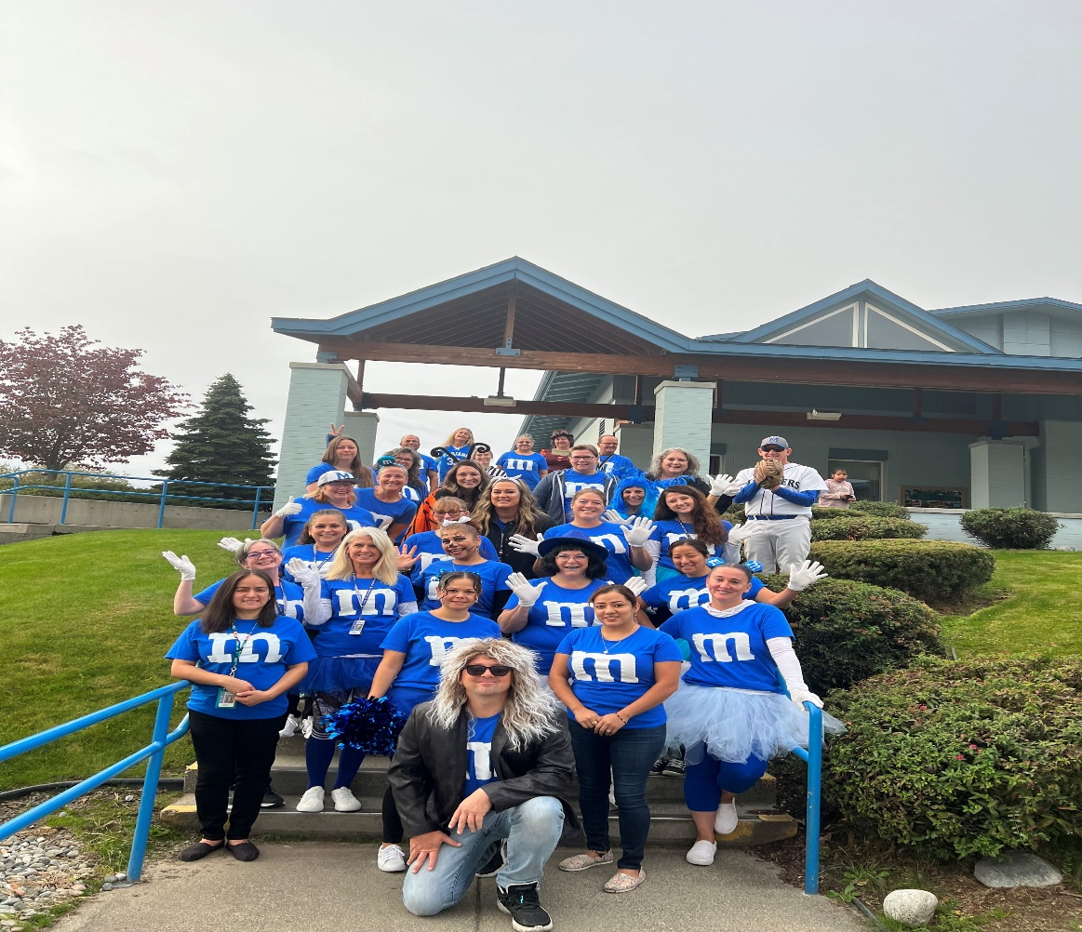
Manson Builds
B = Balanced
We strive to provide a balanced educational experience that incorporates the whole child.
U = United
We, staff, parents, district and community, all work together for the well-being and safety of our students
I = Integrated
We provide integrated, hands-on learning to let kids access knowledge in meaningful ways
L = Learning
We focus on literacy and math as crucial areas to prepare our kids for the future, providing individualized interventions and challenges as needed
D = Diversity
We embrace diversity, respect cultures and languages and teach tolerance.
S = Staff & Students
We have talented and caring educators who work to create meaningful relationships that foster learning for our students.

Slide 3
2022-2023 GOALS
The 3rd - 5th grade students at Manson Elementary will score above the Washington state average in meeting proficiency for their grade level on the Smarter Balance Assessment in Math and ELA as measured by the Spring 2023 SBA assessment.
The achievement gap between low income and non-low income students will decrease by 10% as measured as measured by the summative Spring SBA Math assessment.
100% of our Multi-lingual learners that are assessed on the WIDA Access, will improve their score in the Speaking domain by at least one level as measured by the WIDA Access assessment taken in the Spring of 2023.

Slide 4
Activities
Integration of technology and 1:1 devices in all classroom Updated tablets for k-1st
Use of IABs as formative assessments in grades 3rd -5th and use digital end of unit exams from Benchmark Universe
Use of engaging GLAD strategies in all classrooms
Implementation of new benchmark Advance and Benchmark Adelante curriculum in Kinder – 5th grade Classrooms
Use of strategies focused on improving all wida standard with an emphasis on the Speaking domain in all classrooms
Along with TPEP, the Principal will Implement walkthroughs and provide immediate simple feedback to teachers

Slide 5
Science of Reading and Structured Literacy PD
3 part series lead by Cassie Williams
Part 1: What is the Science of Reading
Part 2: Characteristics of Tier 1 instruction at Manson Elementary
Part 3: Skill Based Instructional Routines

